Slide 1
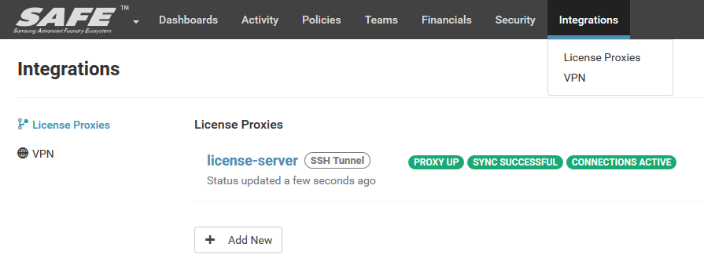

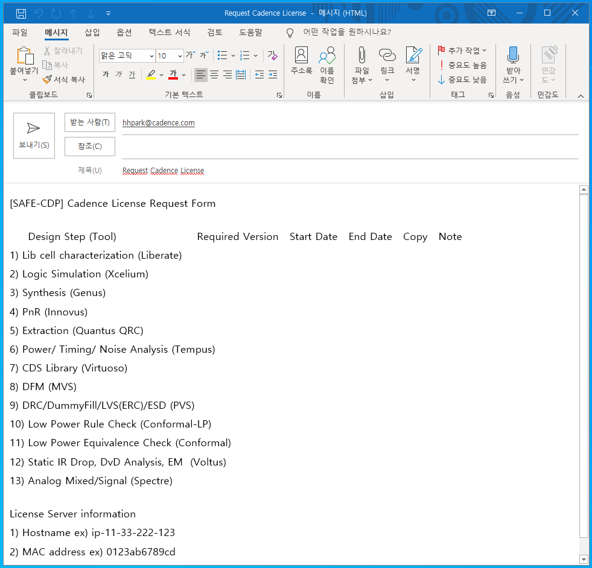
Where to attach menu?
Add New tab on top bar
License Request
License Request
Cadence License Request
When click, pop up the email window

Slide 2
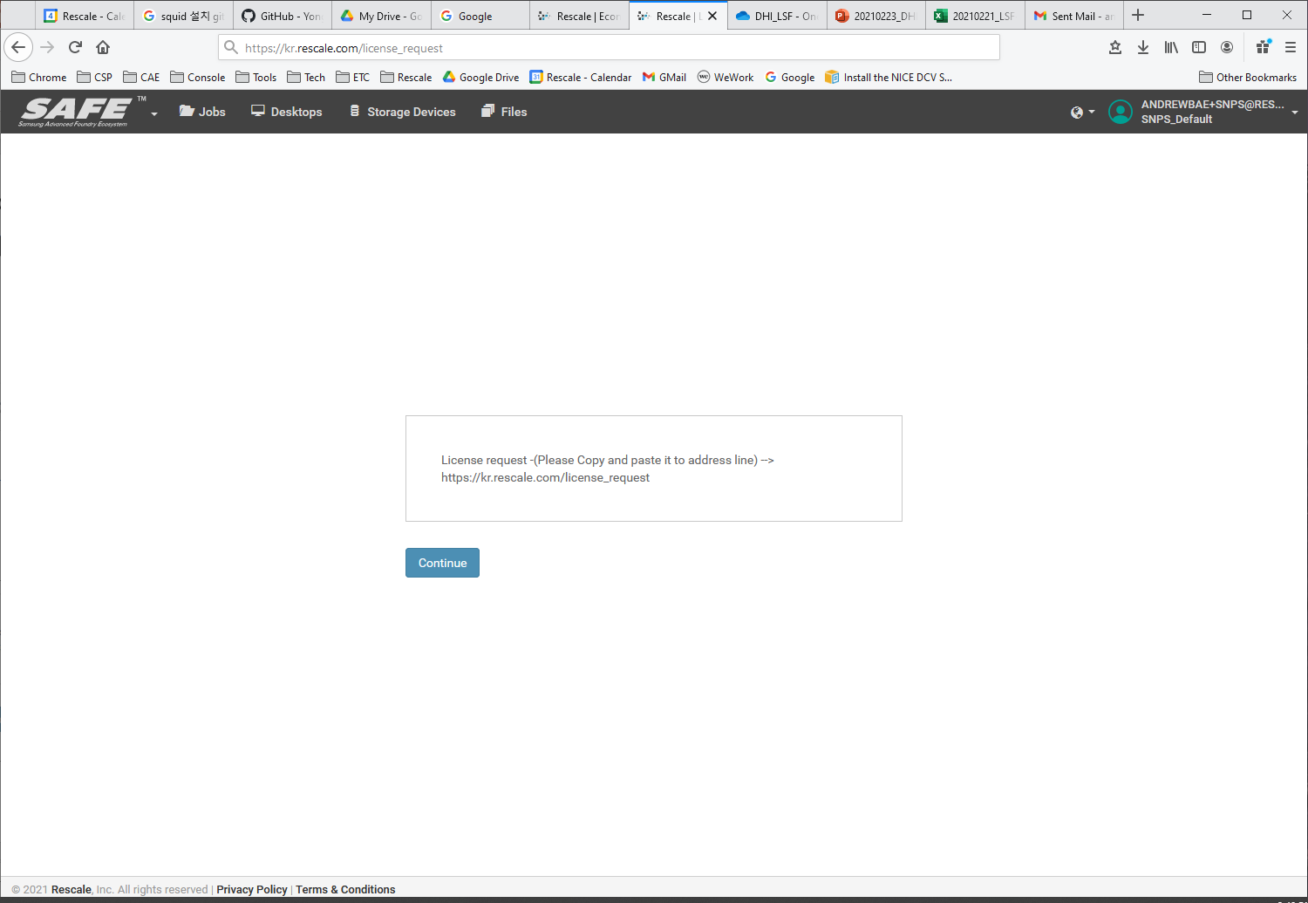


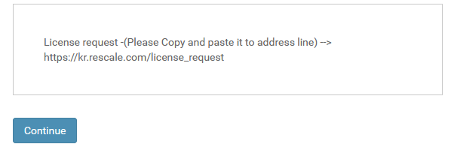
Temporary (until Tab function is available)
License Request
Cadence License Request
When click, pop up the email window
When login, License Request url is shown at the first page.
This is just banner. So it can’t provide link function.
So, copy this address and paste it to address of browser.

Slide 3
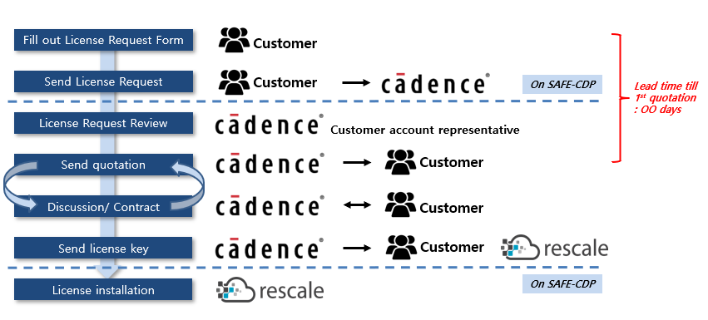
Request process

